Slide 1

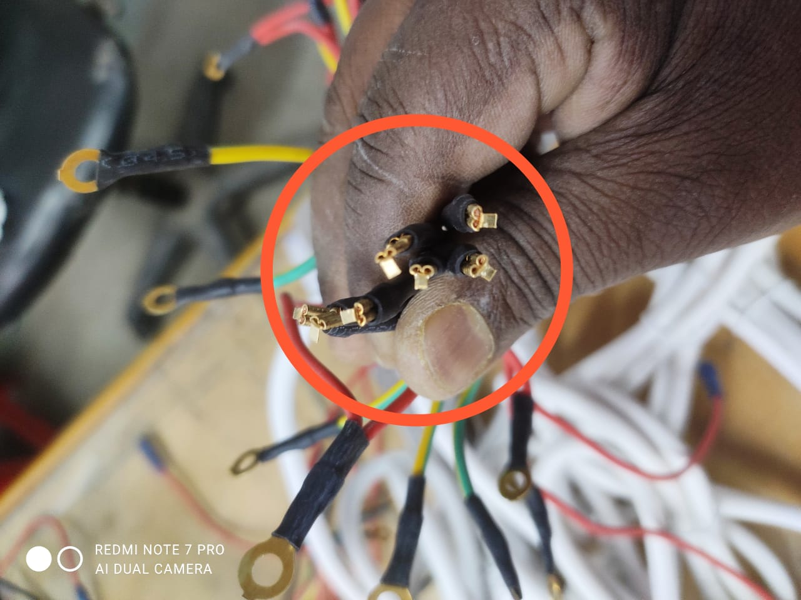
Issue:- Power cord (1.2m)Amica Cutout Thimble Burr.
Date:-02.04.2021
Lot Details
Defect Description Pictures
Part Name:-Power cord
Amica(1.2m)
Suppliers:-Kreative Technology
Date :-01.04.2021
Lot Size/Qty.:- 750 Nos
Check Qty.:- 25 NOS
Rej. Qty.:-8 Nos
Required as per Appearance:- Part OK as per Dimensions & Functionally , Part should be free from wire cutting, Dent misprint , thimble problem& Damaging etc.
Observation:-
Heavy Burr On Cutout Thimble.
Heavy Burr on Cutout Thimble
PREPARED BY:- VIJAY KUSHWAHA
APPROVED BY:-KUMAR SAURABH

